Slide 1


Real ESTATE VIGILANTES
REAL ESTATE INVESTMENT PLANNING

Slide 2





OUR TEAM
SWATHI GANESAN
Data Engineer
SHWETA S KUMAR
Data Engineer
SIDDHARTH P
Data Engineer
JOSE A GERALA
Data Engineer
VISHAL P
Data Engineer

Slide 3

AGENDA
01
BUSINESS CASE
02
METHODOLOGY AND TOOLS
Why Safe Housing
How to solve
Azure
Python
MySQL/Tableau
03
DATA MODEL
04
INSIGHTS
Defining Model
Building Model
Tableau Visualizations
Scores by beat
05
CONCLUSION
06
LESSONS LEARNED
Recommendations
Next Steps & Future Scope
Working with imperfect data
Working with database on Cloud
Notes:
Couldn’t come up with too much for point 1 .. Need to think about it Agenda:
Introduction
Business Case (Problem statements)
Data Model (Reverse Engineering Diagrams) 2 slides
Methodology and Tools (Download, cleaning, uploading to Azure) - 1
Insights (Tableau, Score results) 3 slides- 5 slides
Final recommendation (to the business) 1
Future plans.. (Investments) 1
Lessons learned during this Project 1-2

Slide 4
Business Case
We at Real Estate Vigilantes are working towards building a recommender system, that would help the residents of Chicago find their very own SAFE home.
In this presentation, we will be Scoring the various neighborhoods in Chicago by Crime in those areas.
Notes:
If you find yourself wondering, ‘Is Chicago a safe city to live in?’, the answer is YES IF you have us, the Real Estate Vigilantes help you find a safe neighborhood
We are a new age data science company that are working towards assisting real estate companies add value to their properties

Slide 5
DATA SOURCES
CHICAGO CRIME DATA – Current and up to date crime data from the Chicago Data Portal refreshed and updated every 3 days. Every row in the data is a reported crime with 22 columns and 7.69M rows before data cleaning.
Reference tables :
Created look up tables for Community Area and District Mapping using Wikipedia

Slide 6
DATA PREPARATION
DATA TRIMMING
We chose data from 2013 to Present, as the efficacy of older data could not be verified; however, the entire data set was ingested in case the data can be repurposed later.
Unnecessary and repeated columns have been removed
DATA CLEANING
The dataset is by nature clean. However, missing values were handled by dropping the corresponding entries
The datetime variables were already formatted to MM/DD/YYYY HH:MM:SS AM/PM
Notes:
Data trimming.. We had data from 2001, and we are using only 2013 onwards.
Python script to upload into Azure ( just put a screenshot so that we can show it while we are talking about it )

Slide 7
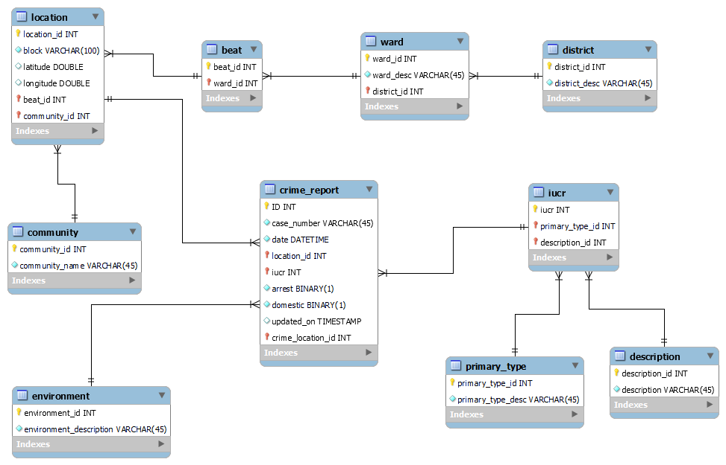
RELATIONAL MODEL – PHYSICAL MODEL - OLD
Notes:
Data is from the Chicago Crimes Database

Slide 8
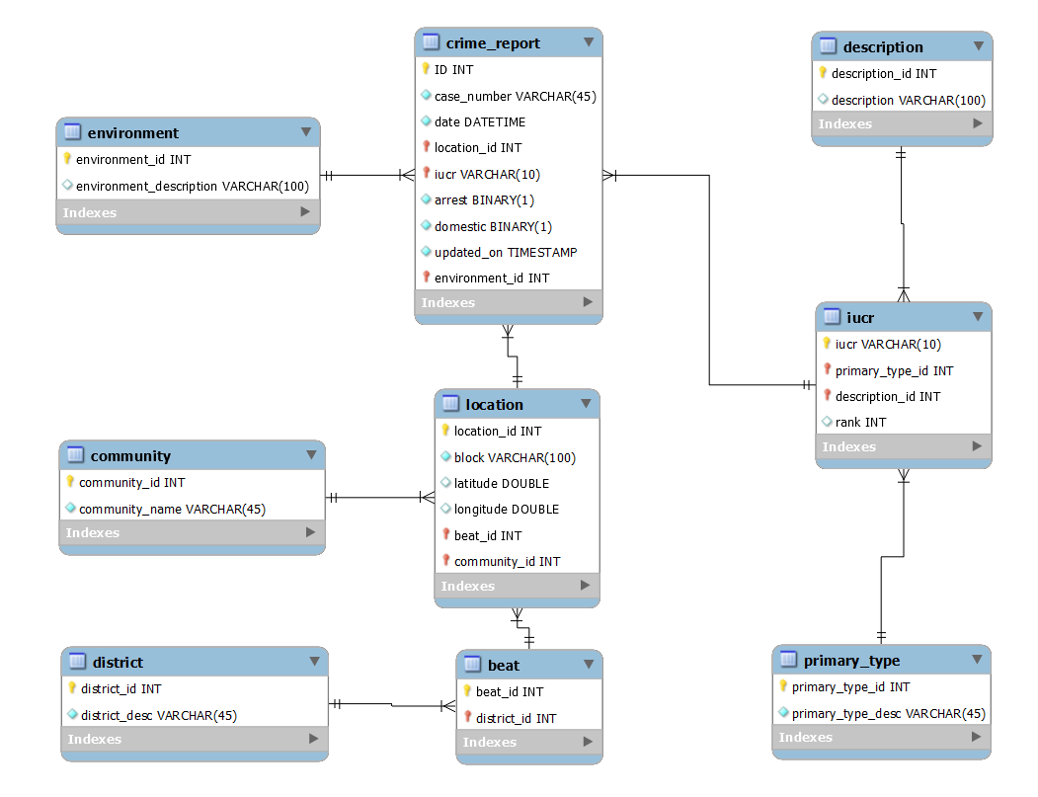
RELATIONAL MODEL – PHYSICAL MODEL - NEW

Slide 9




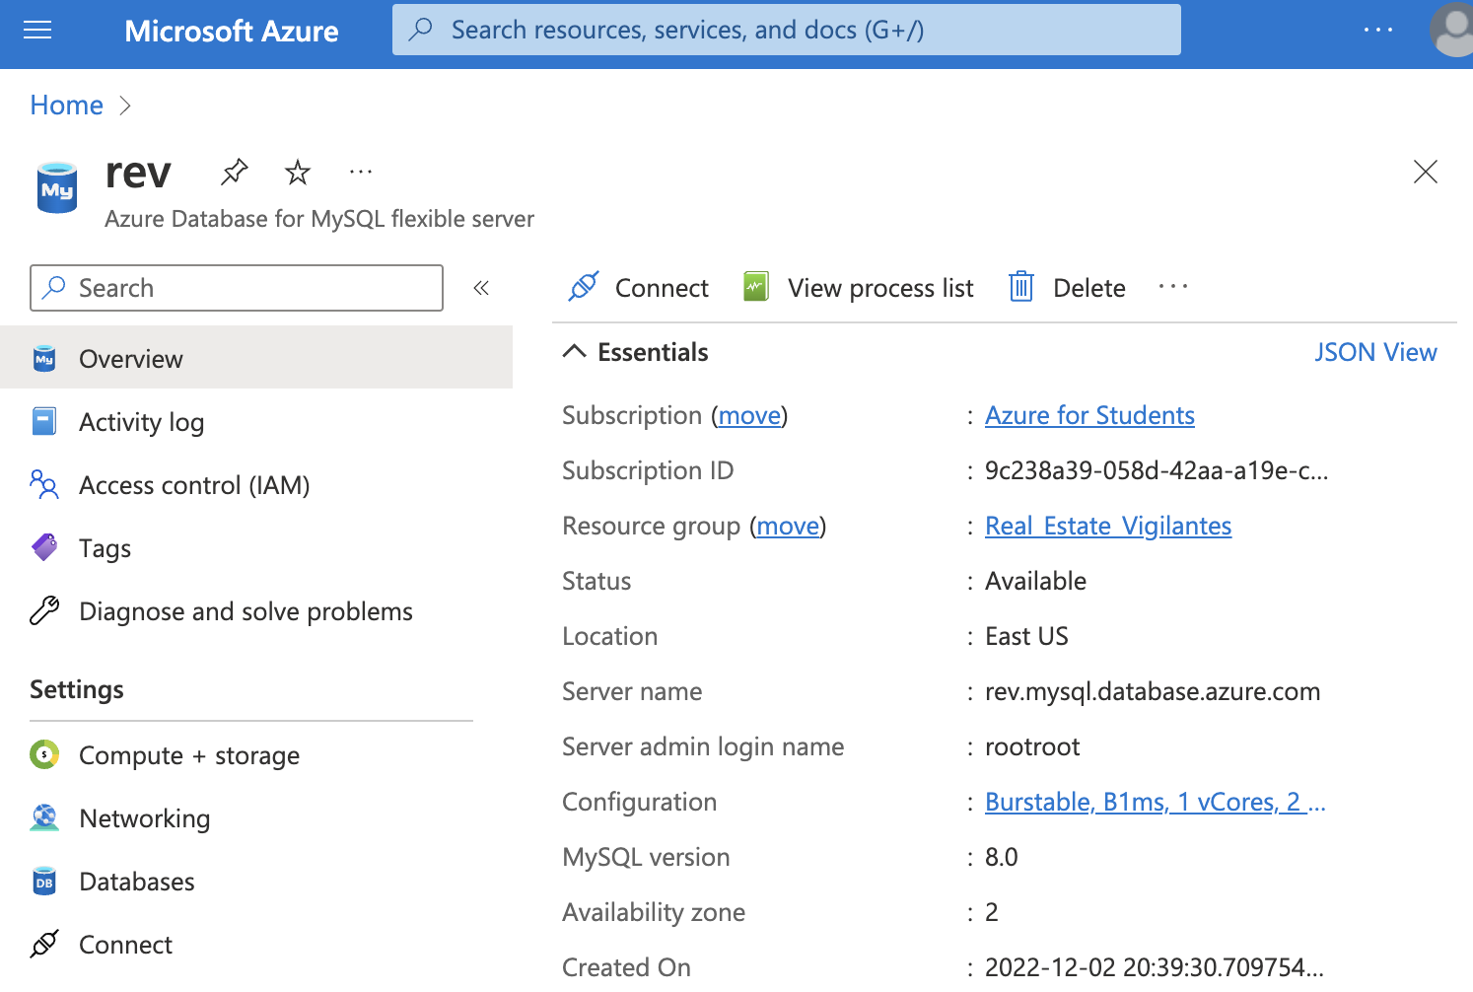
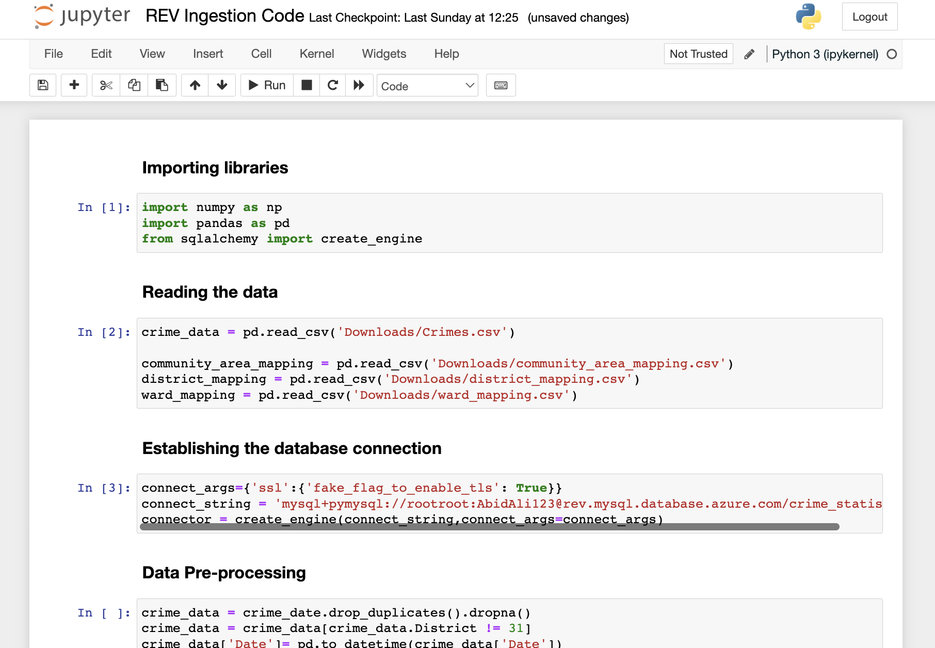

DATA INGESTION
DATABASE CREATION
DATA TRANSFORMATION
DATA ANALYSIS
Created the Database hosted on Azure
Cleaned and normalized the data using Python
Ingested data was ready to be analyzed using MySQL and Tableau
Notes:
Data trimming.. We had data from 2001, and we are using only 2012 onwards.
Python script to upload into Azure ( just put a screenshot so that we can show it while we are talking about it )
Tri Weekkly Ingestor we created

Slide 10
MODEL CREATION
SAFETY SCORE
= 100 – (0.7*NDS) – (0.25*NNS)
NDS : Normalized Day Score NNS : Normalized Night Score
Notes:
Data trimming.. We had data from 2001, and we are using only 2012 onwards.
Python script to upload into Azure ( just put a screenshot so that we can show it while we are talking about it )
Tri Weekkly Ingestor we created

Slide 11
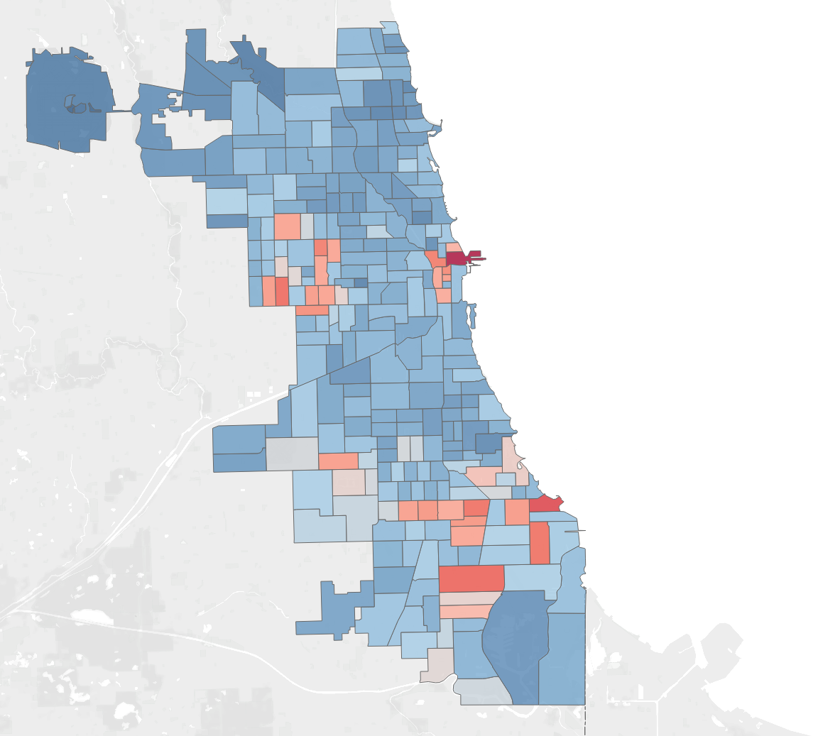
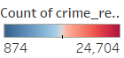
INSIGHTS FROM THE DATA
Plotting by the count of crimes committed in each beat, shows an interesting map, where generally marked as ”unsafe” areas like the south are safer than downtown. This method does not consider the severity of the crime, just that a crime occurred.
Notes:
We can add that nbc tower beat is by numbers the beat where the most crimes happen

Slide 12
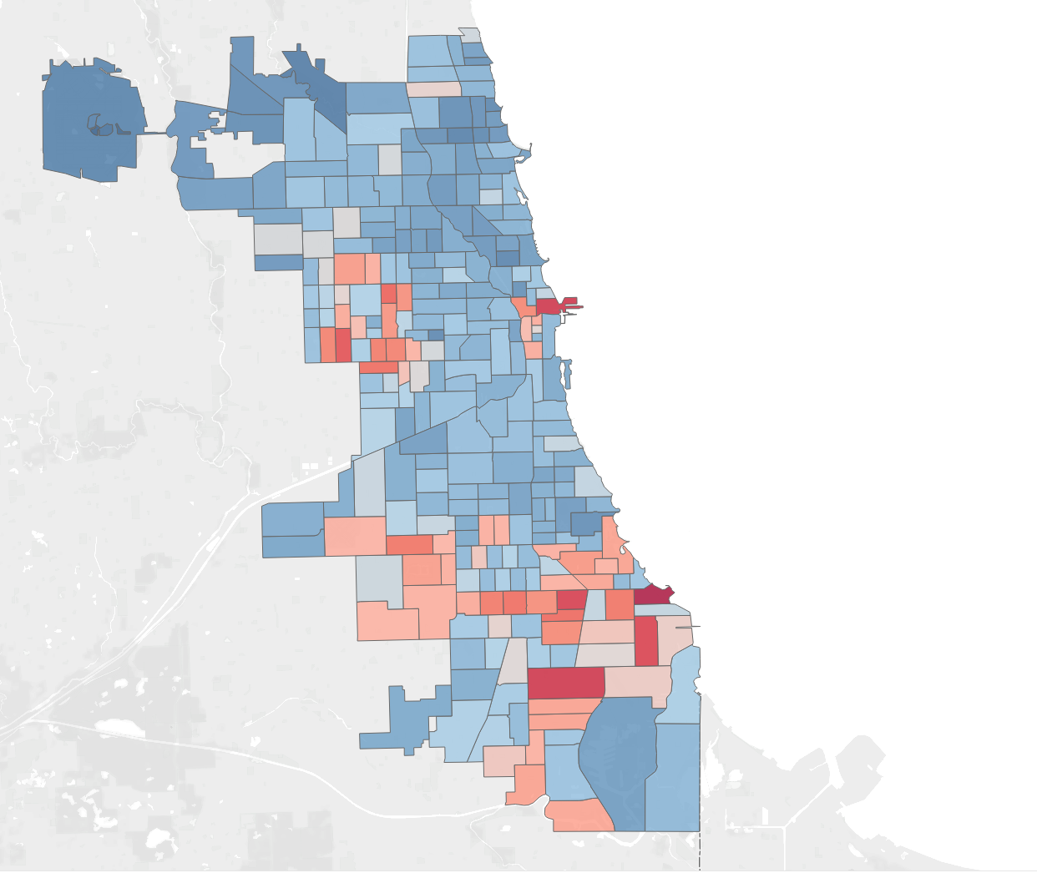
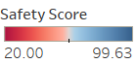
INSIGHTS FROM THE DATA
Further, after implementing our model and generating the safety scores, we can see the areas being marked as unsafe based on the severity of the crime.

Slide 13
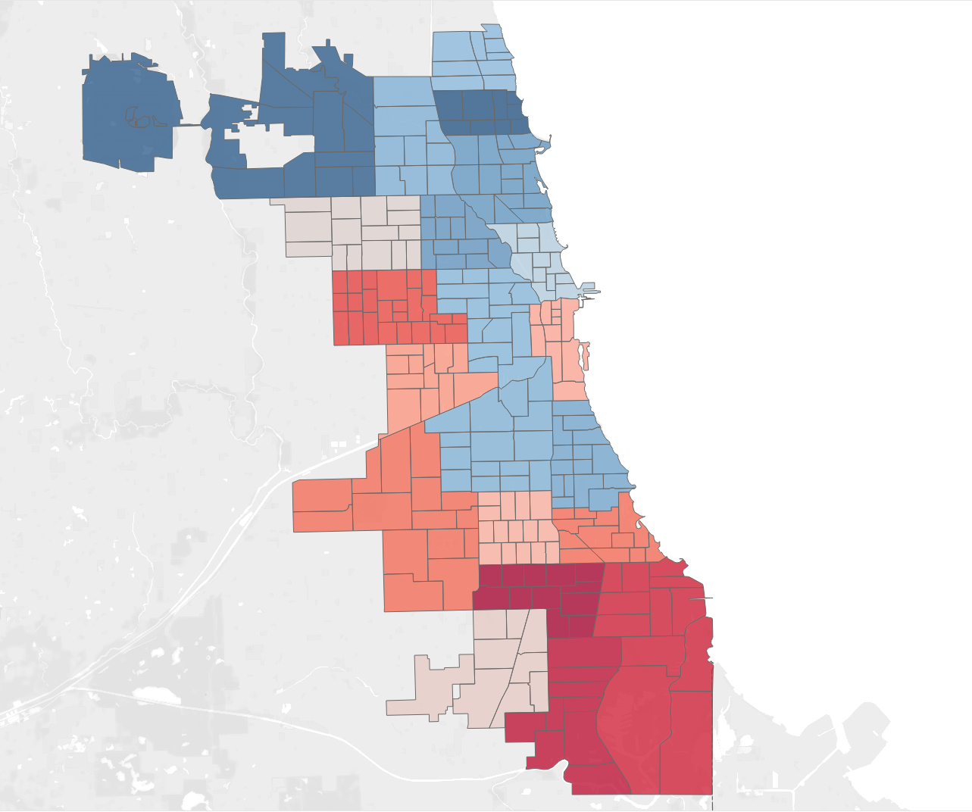
INSIGHTS FROM THE DATA
Districts 16 and 20 and the north of Chicago in general had the highest average scores, while the south of Chicago in general had abysmal safety scores.

Slide 14

RECOMMENDATIONS
Lincoln (District 20) had the Highest Safety score, and Gresham ( District 6 ) had the Lowest Safety score
Beat no 1655 in Jefferson Park had the Highest Score and Beat no 421 in South Chicago had the Lowest Safety score
Forest Glen , Jefferson Park , O'Hare, Uptown, Lincoln Square were calculated as the best community areas to live in
South Shore , Calumet Heights , Avalon Park, Roseland and Pullman were the worst community areas to live in.
Notes:
Decide Which Beat belonging to which District has the Lowest Crime Score.
On a bigger scale Which District has the lowest Crime Score

Slide 15
FUTURE PLANS
Evaluate our IUCR rankings by the police
Establish credibility for local investment properties
Adding other metrics to the model to improve the accuracy of the prediction of the values
Use our model to safety scores of other cities given that they are analytically ready
Utilizing the Location co-ordinates to put older beat data in current beats.
Notes:
Other Metrics could be like School District , Availability of Services such as Police , Fire , Parks etc .
This particular data set has to hide the house numbers for privacy reasons for the victims . So the lowest level we could is the police beat .
Maybe when we integrate other metrics we can get it up to a street in a police beat.
Use this model to evaluate other cities provided they analytical ready

Slide 16
LESSONS LEARNED
Always understand and plan the hierarchy of your data. We faced issues with modifying our data model due to incorrect assumptions
While cloud databases can come with significant deployment efforts, in the long term it provides a lot of benefits
Understanding the history of the data will help in future planning, because we did not follow the changes in Chicago’s police beat system, we had to limit our data to 2013 onwards
Notes:
Working with a Cloud Database at least for some of us
Challenges while uploading Data to the cloud thanks to the null values
Chicago changing the districts in late 2012 which lead to a multitude of problems while we trying to calculate the crime scores

Slide 17
THANK YOU!

